Slide 1
Lecture 1: Software Application Development Models
INF 2105: Software Application Development
COURSE INSTRUCTOR: Akram Ali Omar
Email: akram.ali.omar@gmail.com
Mobile: +255778695626

Slide 2
What is the System Development Cycle?
Structured step-by-step approach for developing information systems
It describe the process of planning, building, using, and updating an information system.
It consists of a series of phases, each with its own set of activities and deliverables.
Understanding SDLC is crucial for software developers, project managers, and other stakeholders involved in the software development process

Slide 3
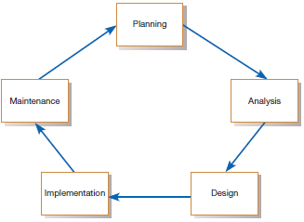
Phases of SDLC
Each phase has its own set of objectives and deliverables that must be completed before moving on to the next phase.

Slide 4
Phases of SDLC
Project planning – initiate, identify the scope, determine project goals and objectives, ensure feasibility, plan schedule, obtain approval for project
Analysis – understand business needs and processing requirements
Design – define solution system based on requirements and analysis decisions
Implementation – construct, test, train users, and install new system
Support – keep system running , improve, fix defects, make enhancements, and provide support to the users.

Slide 5
SDLC Models
The followings are most common SDLC Models:
Waterfall Model
Iterative Model
Spiral Model
V – model
Prototyping Models
Agile Model
Big Bang Model
Rapid Application Development

Slide 6
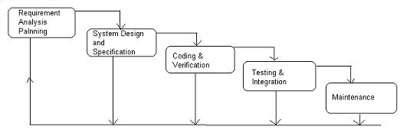
Waterfall Model
All the phases of SDLC will function one after another in linear manner
Each phase must be completed fully before the next phase can begin
In this model software testing starts only after the development is complete.
In waterfall model phases do not overlap

Slide 7
Waterfall Model
Requirement Gathering and analysis
All possible requirements of the system to be developed are captured in this phase and documented in a requirement specification document
System Design
The requirement specifications from first phase are studied in this phase and the system design is prepared.
This system design helps in specifying hardware and system requirements and helps in defining the overall system architecture

Slide 8
Waterfall Model
Implementation
With inputs from the system design, the system is first developed in small programs called units, which are integrated in the next phase.
Each unit is developed and tested for its functionality, which is referred to as Unit Testing
Integration and Testing
All the units developed in the implementation phase are integrated into a system after testing of each unit.
Finally after integration the entire system is tested for any faults and failures.

Slide 9
Waterfall Model
Maintenance
There are some issues which come up in the client environment.
To fix those issues, patches are released.
Also to enhance the product some better versions are released

Slide 10
When to use Waterfall Model?
Some situations where the use of Waterfall model is most appropriate are
Requirements are very well documented, clear and fixed.
Product definition is stable.
Technology is understood and is not dynamic.
There are no ambiguous requirements.
The project is short.

Slide 11
Advantages of waterfall model
Easy to explain to the user
Stages and activities are well defined
Helps to plan and schedule the project
Verification at each stage ensures early detection of errors / misunderstanding

Slide 12
Disadvantages of waterfall model
No working software is produced until late during the life cycle.
High amounts of risk and uncertainty.
Not a good model for complex and object-oriented projects.
Poor model for long and ongoing projects.
Not suitable for the projects where requirements are at a moderate to high risk of changing. So, risk and uncertainty is high with this process model.
It is difficult to measure progress within stages.
Cannot accommodate changing requirements.
Customers can not use anything until the entire system is complete

Slide 13
Project Output in a Waterfall Model
Requirement document
Project plan
System design document
Detailed design document
Test plan and test report
Final code
Software manuals (user manual, installation manual etc.)
Review reports

Slide 14
V- model
V- model means Verification and Validation model
Just like the waterfall model, the V-Shaped life cycle is a sequential path of execution of processes
It consists of a series of phases, each of which has a corresponding testing phase
Testing of the product is planned in parallel with a corresponding phase of development in V-model

Slide 15
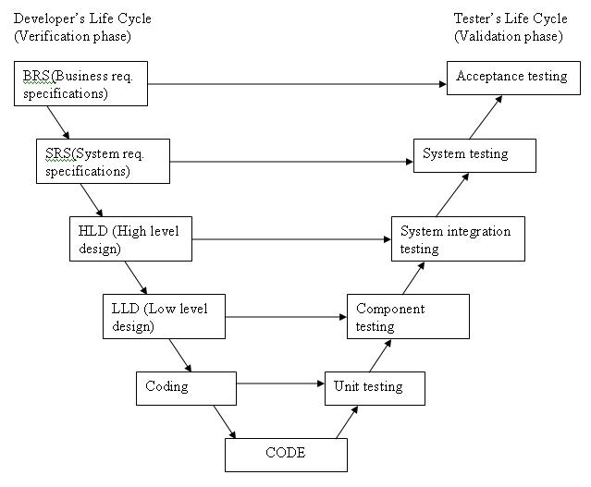
V- model

Slide 16
Disadvantages of V-model
Very rigid and least flexible.
Software is developed during the implementation phase, so no early prototypes of the software are produced.
If any changes happen in midway, then the test documents along with requirement documents has to be updated.

Slide 17
When to use the V-model
The V-shaped model should be used for small to medium sized projects where requirements are clearly defined and fixed.
The V-Shaped model should be chosen when sample technical resources are available with needed technical expertise.
Note:
High confidence of customer is required for choosing the V-Shaped model approach. Since, no prototypes are produced, there is a very high risk involved in meeting customer expectations.

Slide 18
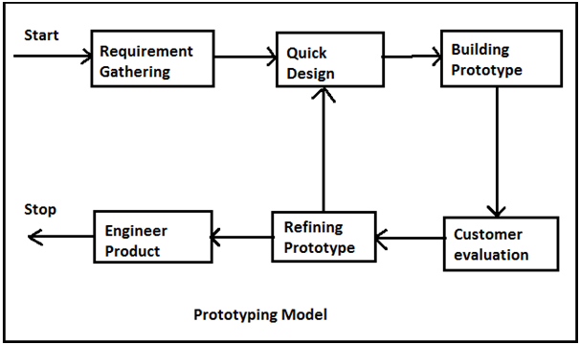
Prototyping model

Slide 19
Advantages of Prototype model
Users are actively involved in the development
The users get a better understanding of the system being developed.
Errors can be detected much earlier.
Quicker user feedback is available leading to better solutions.
Missing functionality can be identified easily
Confusing or difficult functions can be identified
Requirements validation, Quick implementation of incomplete but functional application.

Slide 20
Disadvantages of Prototype model
Leads to implementing and then repairing way of building systems.
Practically, this methodology may increase the complexity of the system as scope of the system may expand beyond original plans.
Incomplete application may cause application not to be used as the full system was designed
Incomplete or inadequate problem analysis.

Slide 21
When to use Prototype model
When the desired system needs to have a lot of interaction with the end users.
Typically, online systems, web interfaces have a very high amount of interaction with end users, are best suited for Prototype model

Slide 22
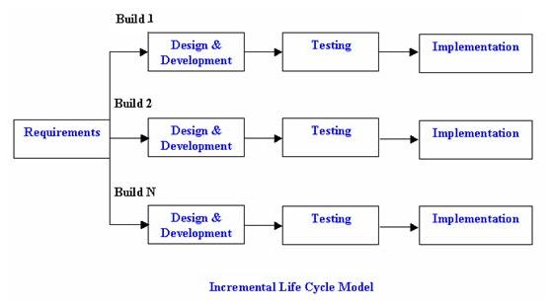
Iterative & Incremental model

Slide 23
Advantages of Iterative & Incremental model
Generates working software quickly and early during the software life cycle.
This model is more flexible – less costly to change scope and requirements.
It is easier to test and debug during a smaller iteration.
In this model customer can respond to each built.
Lowers initial delivery cost.
Easier to manage risk because risky pieces are identified and handled during it’s iteration.

Slide 24
Disadvantages of Iterative & Incremental model
Needs good planning and design.
Needs a clear and complete definition of the whole system before it can be broken down and built incrementally.
Total cost is higher than waterfall.

Slide 25
When to use the Iterative & Incremental model
This model can be used when the requirements of the complete system are clearly defined and understood.
Major requirements must be defined; however, some details can evolve with time.
There is a need to get a product to the market early.
A new technology is being used
Resources with needed skill set are not available
There are some high risk features and goals

Slide 26
Agile development model
Is also a type of Incremental model
Breaks tasks into small increments with minimal planning
Iterations are short time frames that typically last from one to four weeks
Each iteration involves planning, requirements analysis, design, coding, unit testing, and acceptance testing
At the end of the iteration a working product is demonstrated to stakeholders

Slide 27
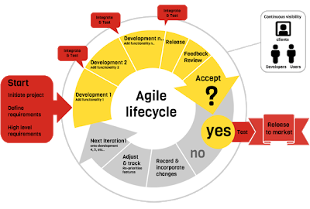
Agile development model

Slide 28
Advantages of Agile model
Customer satisfaction by rapid, continuous delivery of useful software.
People and interactions are emphasized rather than process and tools.
Customers, developers and testers constantly interact with each other.
Working software is delivered frequently (weeks rather than months).
Face-to-face conversation is the best form of communication.
Close, daily cooperation between business people and developers.
Regular adaptation to changing circumstances.
Even late changes in requirements are welcomed

Slide 29
Disadvantages of Agile model
In case of some software deliverables, especially the large ones, it is difficult to assess the effort required at the beginning of the software development life cycle.
There is lack of emphasis on necessary designing and documentation.
The project can easily get taken off track if the customer representative is not clear what final outcome that they want.
Only senior programmers are capable of taking the kind of decisions required during the development process. Hence it has no place for newbie programmers, unless combined with experienced resources.

Slide 30
Choosing the right Software development life cycle model
Understanding the different SDLC models is important for software developers, project managers, and other stakeholders involved in the software development process.
Each model has its own strengths and weaknesses, and the right model should be chosen based on the specific requirements of the project.
Using an appropriate SDLC model can help to ensure that the software development process is efficient, effective, and produces high-quality software.

Slide 31
Choosing the right Software development life cycle model
Selecting the right SDLC is a process in itself that organization can implement internally or consult for
Steps to get the right selection.
STEP 1: Learn the about SDLC Models - already covered
STEP 2: Assess the needs of Stakeholders
STEP 3: Define the criteria
STEP 4: Decide

Slide 32
STEP 2: Assess the needs of Stakeholders
We must study the business domain, stakeholders concerns and requirements, business priorities, our technical capability and ability, and technology constraints to be able to choose the right SDLC against their selection criteria.

Slide 33
STEP 3: Define the criteria
Some of the selection criteria or arguments that you may use to select an SDLC are:
Is the SDLC suitable for the size of our team and their skills?
Is the SDLC suitable for the selected technology we use for implementing the solution?
Is the SDLC suitable for client and stakeholders concerns and priorities?
Is the SDLC suitable for the geographical situation (distributed team)?
Is the SDLC suitable for the size and complexity of our software?
Is the SDLC suitable for the type of projects we do?
Is the SDLC suitable for our software engineering capability?

Slide 34
Some Recommended criteria
Factors | Waterfall | V-Shaped | Prototyping | Spiral | Iterative & Incremental | Agile
Unclear User Requirement | Poor | Poor | Good | Excellent | Good | Excellent
Unfamiliar Technology | Poor | Poor | Excellent | Excellent | Good | Poor
Complex System | Good | Good | Excellent | Excellent | Good | Poor
Reliable system | Good | Good | Poor | Excellent | Good | Good
Short Time Schedule | Poor | Poor | Good | Poor | Excellent | Excellent
Strong Project Management | Excellent | Excellent | Excellent | Excellent | Excellent | Excellent
Cost limitation | Poor | Poor | Poor | Poor | Excellent | Excellent
Visibility of Stakeholders | Good | Good | Excellent | Excellent | Good | Excellent
Skills limitation | Good | Good | Poor | Poor | Good | Poor
Documentation | Excellent | Excellent | Good | Good | Excellent | Poor
Component reusability | Excellent | Excellent | Poor | Poor | Excellent | Poor

Slide 35
Software Development Approaches to SDLC
Two common approaches in software development
Traditional Approach(structured approach)
object-oriented (OO) approach

Slide 36
Structured vs. OO Methodology
Object-Oriented Approach | Structured Approach
Focuses on objects (with properties and behaviors) | Focuses on processes (step-by-step execution)
Data and operations are encapsulated within objects | Data and operations are separate
Bottom-up development (building from smaller components) | Top-down development (breaking down a problem into smaller subproblems)
Inheritance and polymorphism support code reuse | Modularization supports code reuse
Real-world modeling is more intuitive | Less intuitive for complex systems
Typically used for larger, complex systems | Suitable for smaller, simpler systems
Examples: Java, C++, Python | Examples: C, Pascal
Notes:
Inception Phase: The goal of the Inception phase is to establish the feasibility of the project and develop a high-level understanding of the requirements. The key activities in this phase include defining the project scope, identifying stakeholders, establishing project goals and objectives, and defining the project plan. Deliverables of this phase may include a project charter, feasibility study, and initial requirements.
Elaboration Phase: The goal of the Elaboration phase is to refine the requirements and develop a detailed project plan. In this phase, the development team works with stakeholders to develop a more detailed understanding of the requirements and define the software architecture. The key activities in this phase include developing use cases, refining the requirements, creating a detailed design, and developing a prototype. Deliverables of this phase may include a detailed project plan, a requirements document, a software architecture document, and a prototype.
Construction Phase: The goal of the Construction phase is to build the software system based on the requirements and design developed in the previous phases. In this phase, the development team focuses on coding, testing, and integrating the software modules. The key activities in this phase include coding, unit testing, integration testing, and system testing. Deliverables of this phase may include a working software system, user documentation, and training materials.
Transition Phase: The goal of the Transition phase is to deploy the software system into production and ensure that it is ready for use by end-users. In this phase, the development team focuses on final testing, user acceptance testing, and training. The key activities in this phase include final testing, user acceptance testing, deployment, and training. Deliverables of this phase may include a final software release, user manuals, and support materials.

Slide 37
END!

